Slide 1


Slide 2

INTRODUCTION TO MATPLOTLIB
Matplotlib is an amazing visualization library in Python for 2D plots of arrays

Slide 3

Matplotlib is an amazing visualization library in Python for 2D plots of arrays
Matplotlib is a multi-platform data visualization library built on NumPy arrays and designed to work with the broader SciPy stack. It was introduced by John Hunter in the year 2002.
One of the greatest benefits of visualization is that it allows us visual access to huge amounts of data in easily digestible visuals.
Matplotlib consists of several plots like line, bar, scatter, histogram etc

Slide 4
Importing matplotlib :
from matplotlib import pyplot as plt or
import matplotlib.pyplot as plt

Slide 5
Basic plots in Matplotlib :
Matplotlib comes with a wide variety of plots.
Plots helps to understand trends, patterns, and to make correlations.
They’re typically instruments for reasoning about quantitative information.

Slide 6
Line plot :
# importing matplotlib from matplotlib import |  | module pyplot | as | plt
•
• • • | # x-axis values x = [5, 2, 9, 4, 7]
• • • | # Y-axis values y = [10, 5, 8, 4, 2]
• • • | # Function to plot plt.plot(x,y)
• • | # function to show the plt.show() | plot

Slide 7
Bar plot :
# importing matplotlib module
from matplotlib import pyplot as plt
•
# x-axis values
x = [5, 2, 9, 4, 7]
•
•
# Function to plot the bar
plt.bar(x,y)
•
# function to show the plot
plt.show()
# | Y-axis | values
y | = [10, | 5, 8, | 4, | 2]

Slide 8
Histogram :
# importing matplotlib module
from matplotlib import pyplot as plt
•
# Y-axis values
y = [10, 5, 8, 4, 2]
•
# Function to plot histogram
plt.hist(y)
•
# Function to show the plot
plt.show()

Slide 9
Scatter Plot :
# importing matplotlib | module
from matplotlib import | pyplot | as | plt
•
# x-axis values
x = [5, 2, 9, 4, 7]
•
•
# Function to plot scatter
plt.scatter(x, y)
•
# function to show the plot
plt.show()
# | Y-axis | values
y | = [10, | 5, 8, | 4, | 2]

Slide 10
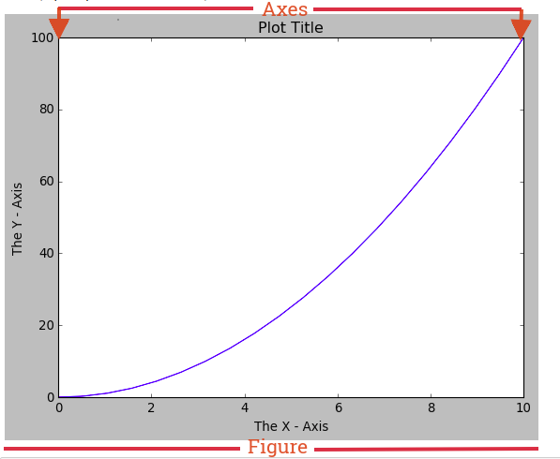

Slide 11
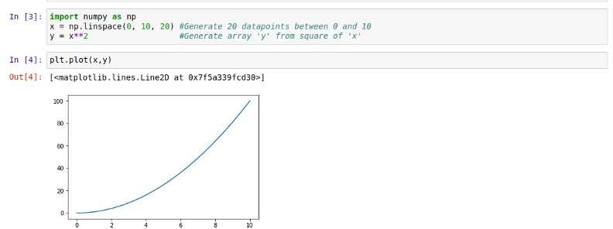
Functional Approach:

Slide 12
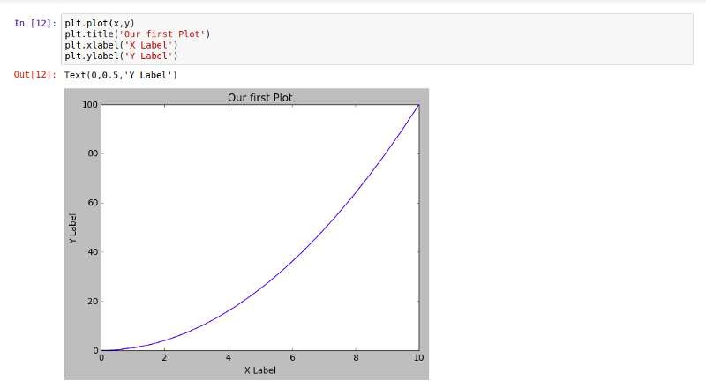

Slide 13
Matplotlib allows us easily create multi-plots on the same figure using the .subplot() method. This .subplot() method takes in three parameters, namely:
nrows: the number of rows the Figure should have.
ncols: the number of columns the Figure should have.
plot_number : which refers to a specific plot in the Figure.

Slide 14
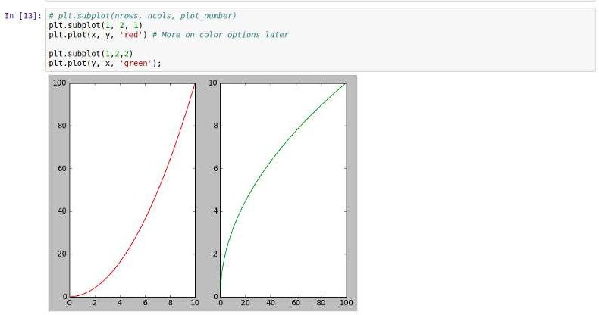
Using .subplot() we will create a two plots on the same canvas:

Slide 15
Object oriented Interface:
This is the best way to create plots.
The idea here is to create Figure objects and call methods off it. Let’s create a blank Figure using the .figure() method

Slide 16
Next step
Now we need to add a set of axes
.add_axes()
(left, bottom, width, and height)
•

Slide 17
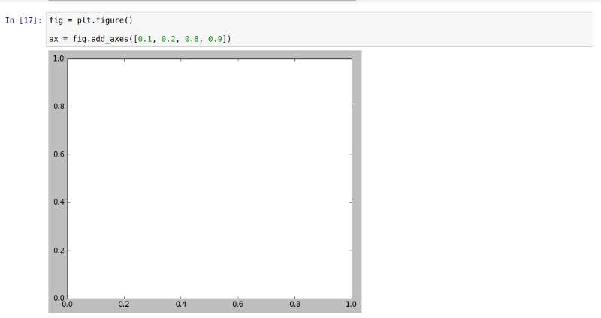

Slide 18
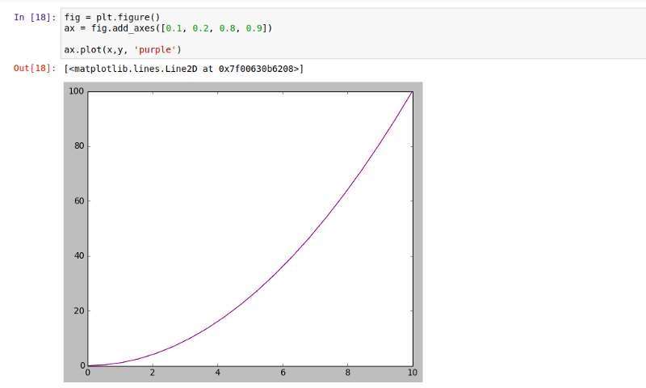

Slide 19
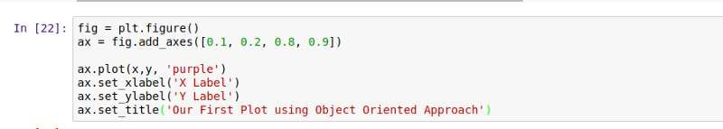

Slide 20
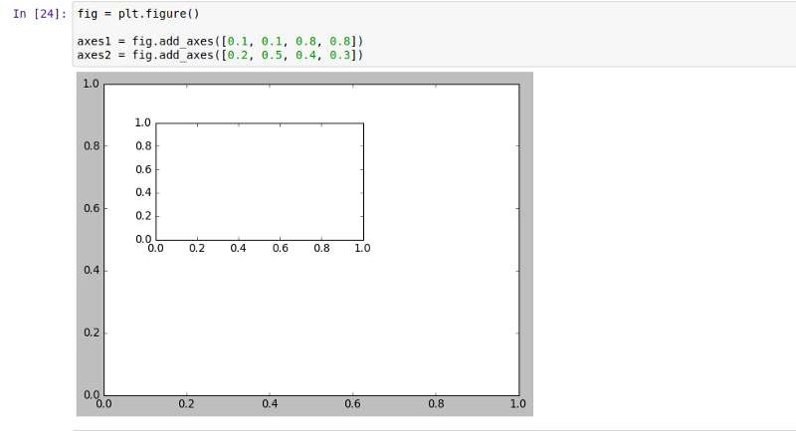
Something interesting , figure in figure

Slide 21
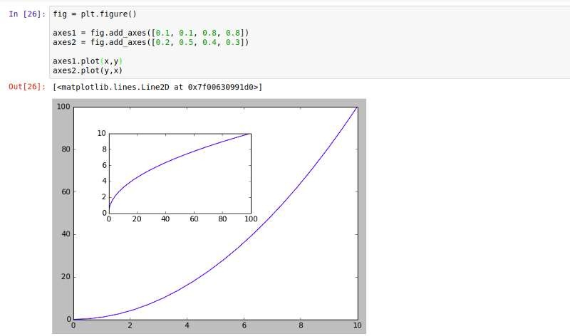

Slide 22
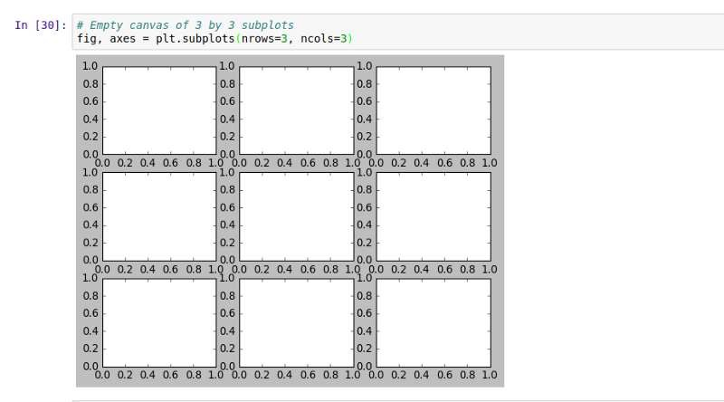
We can create a matrix of subplot for example 3*3

Slide 23
Add , plot.tight_layout()
The only difference between plt.figure() and plt.subplots() is that
plt.subplots() automatically does
what the .add_axes() method of .figure() will do for you based off
the number of rows and columns you specify.

Slide 24
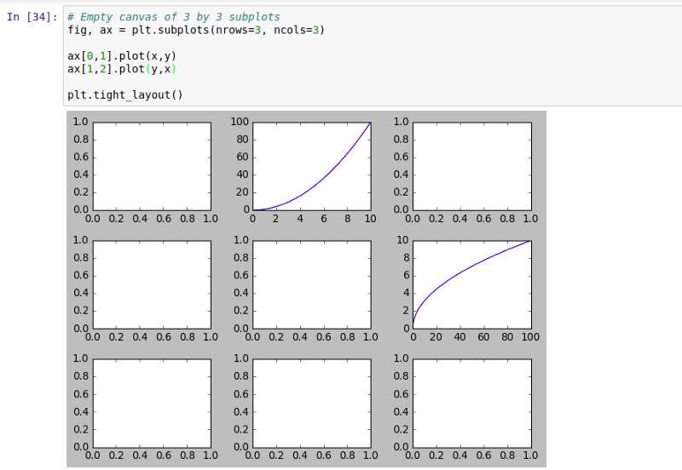

Slide 25
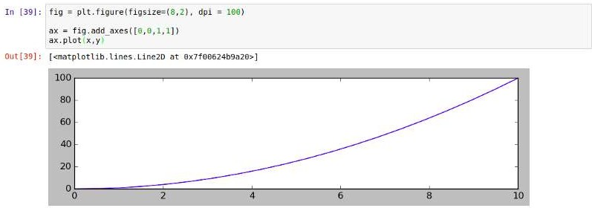
Figure size, aspect ratio, and DPI IN FIGURE

Slide 26
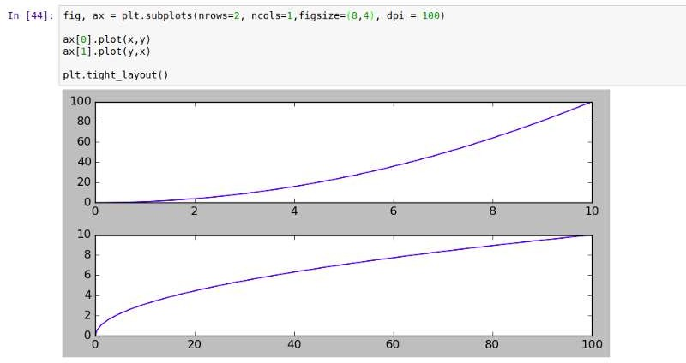
IN SUBPLOTS

Slide 27
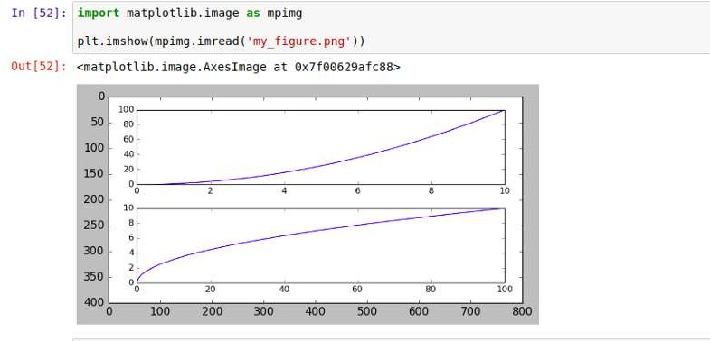
THE BROTHER CAN SAVE PICTURE ALSO VIA
FIG.SAVEFIG(‘NAME.PNG’)

Slide 28
Legends
Legends allows us to distinguish between plots. With Legends, you can use label texts to identify or differentiate one plot from another. For example, say we have a figure having two plots like below:

Slide 29
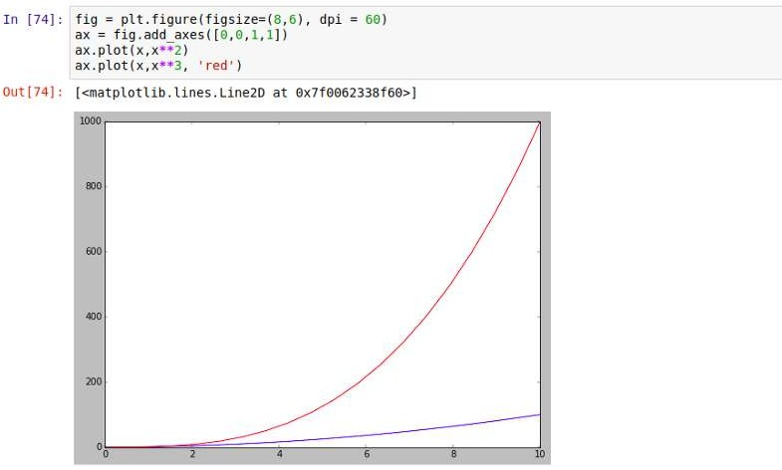

Slide 30
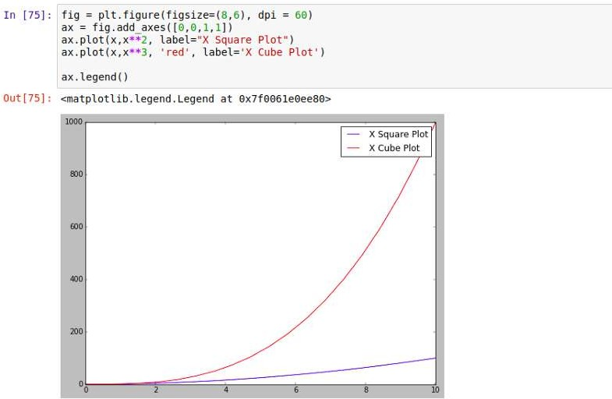

Slide 31
Plot Types
HISTOGRAM
HELPS US UNDERSTAND THE DISTRIBUTION OF NUMERIC VALUE IN A WAY THAT YOU CAN NOT DO WITH MEAN , MEDIAN , MODE

Slide 32
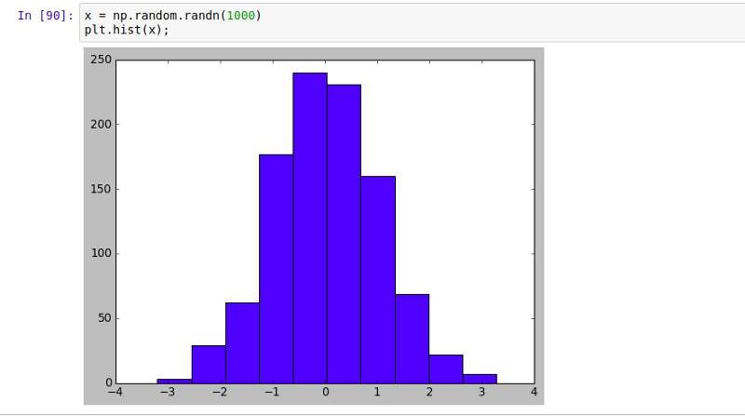

Slide 33
Time series (Line Plot)
is a chart that shows a trend over a period of time.
It allows you to test various hypotheses under certain conditions, like what happens different days of the week or between different times of the day.

Slide 34
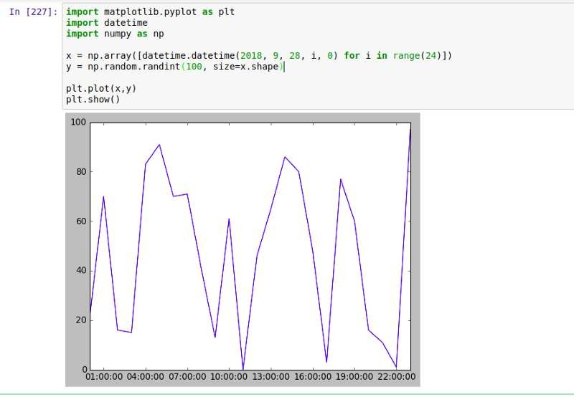
EXAMPLE

Slide 35
Scatter plots
offer a convenient way to visualize how two numeric values are related in your data.
It helps in understanding relationships between multiple variables.
Using .scatter() method, we can create a scatter plot:
EXAMPLE

Slide 36
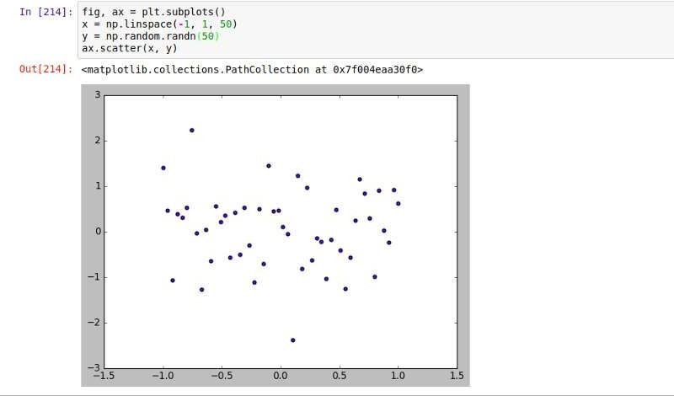

Slide 37
Bar graphs
are convenient for comparing numeric values of several groups. Using .bar() method, we can create a bar graph:

Slide 38
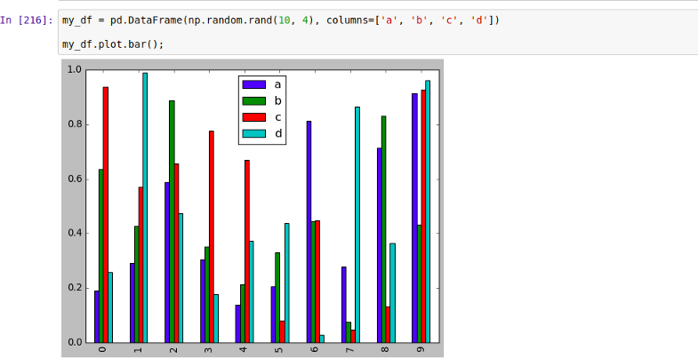

Slide 39


